Slide 1

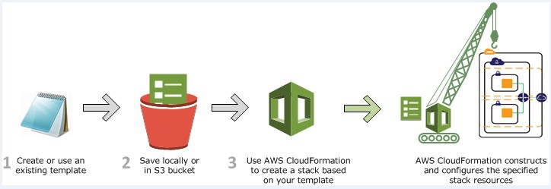
AWS CLOUDFORMATION
AWS CloudFormation is a service that helps you model and set up your Amazon Web Services resources.
You create a template that describes all the AWS resources that you want (like Amazon EC2 instances or Amazon RDS DB instances), and AWS CloudFormation takes care of provisioning and configuring those resources for you.
You don't need to individually create and configure AWS resources and figure out what's dependent on what; AWS CloudFormation handles all of that.

Slide 2
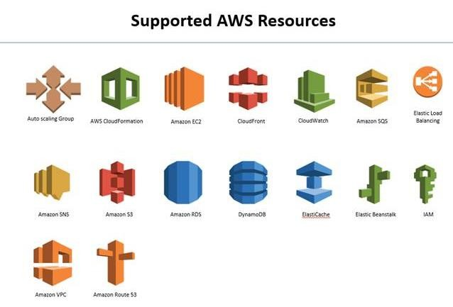


Slide 3
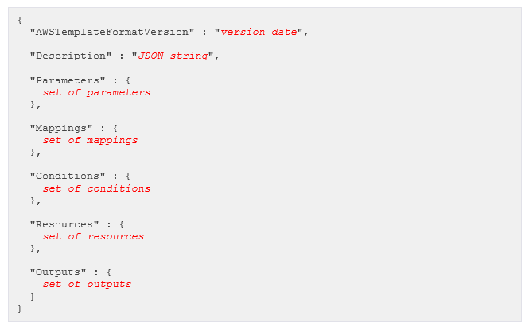
AWS CLOUDFORMATION ANATOMY
Format Version (optional)
Specifies the AWS CloudFormation template version that the template conforms to.
"AWSTemplateFormatVersion" : "2010-09-09"
Description (optional)
A text string that describes the template. This section must always follow the template format version section.
"Description" : "Test environment for Client B."

Slide 4
Parameters (optional)
Specifies values that you can pass in to your template at runtime (when you create or update a stack). You can refer to parameters in the Resources and Outputs sections of the template.
"Parameters" : { "DBPort" : { "Default" : "3306",
"Description" : "TCP/IP port for the database", "Type" : "Number",
"MinValue" : "1150",
"MaxValue" : "65535"
},
"DBPwd" : {
"NoEcho" : "true",
"Description" : "The database admin account password", "Type" : "String",
"MinLength" : "1",
"MaxLength" : "41", "AllowedPattern" : "[a-zA-Z0-9]*"
}
}
Mappings (optional)
A mapping of keys and associated values that you can use to specify conditional parameter values, similar to a lookup table. You can match a key to a corresponding value by using the Fn::FindInMap intrinsic function in the Resources and Outputs section.
“Mappings” :{
"RegionMap" : {
"us-east-1" : "ami-7a11e213",
"us-west-1" : "ami-cfc7978a",
"eu-west-1" : "ami-31c2f645", "ap-southeast-1" : "ami-60f28c32", "ap-northeast-1" : "ami-a003a8a1"
},
}

Slide 5
Conditions (optional)
Defines conditions that control whether certain resources are created or whether certain resource properties are assigned a value during stack creation or update. For example, you could conditionally create a resource that depends on whether the stack is for a production or test environment.
{
"AWSTemplateFormatVersion" : "2010-09-09", "Parameters" : {
"EnvType" : {
"Description" : "Environment type.", "Default" : "test",
"Type" : "String",
"AllowedValues" : ["prod", "test"], "ConstraintDescription" : "must specify prod or test."
}
},
"Conditions" : {
"CreateProdResources" : {"Fn::Equals" : [{"Ref" : "EnvType"}, "prod"]}
},
"Resources" : { "EC2Instance" : {
"Type" : "AWS::EC2::Instance", "Properties" : {
"ImageId" : "ami-2f726546"
}
},
"NewVolume" : {
"Type" : "AWS::EC2::Volume", "Condition" : "CreateProdResources", "Properties" : {
"Size" : "100",
"AvailabilityZone" : { "Fn::GetAtt" : [ "EC2Instance", "AvailabilityZone" ]}
}
},
"MountPoint" : {
"Type" : "AWS::EC2::VolumeAttachment", "Condition" : "CreateProdResources", "Properties" : {
"InstanceId" : { "Ref" : "EC2Instance" },
"VolumeId" : { "Ref" : "NewVolume" }, "Device" : "/dev/sdh"

Slide 6
}
}
},
}
Resources (required)
Specifies the stack resources and their properties, such as an Amazon Elastic Compute Cloud instance or an Amazon Simple Storage Service bucket.
"Resources" : { "MyEC2Instance" : {
"Type" : "AWS::EC2::Instance", "Properties" : {
"ImageId" : "ami-2f726546"
}
}
}
Outputs (optional)
Describes the values that are returned whenever you view your stack's properties.
"Outputs" : { "InstanceID" : {
"Description": "The Instance ID", "Value" : { "Ref" : "EC2Instance" }
}
}

Slide 7
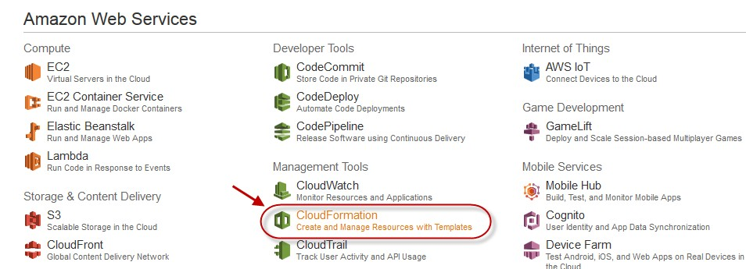
CLOUDFORMATION SAMPLE TEMPLATE
you can download sample template for WordPress Multi AZ installation with ELB and Autoscaling configured.
http://s3.amazonaws.com/cloudformation-templates-us-east- 1/WordPress_Multi_AZ.template
Once you logged in to AWS Management Console, create a key pair from EC2 page if you have not created already.
Form Console home page choose CloudFormation under Management Tools.
Then choose Create New Stack.

Slide 8
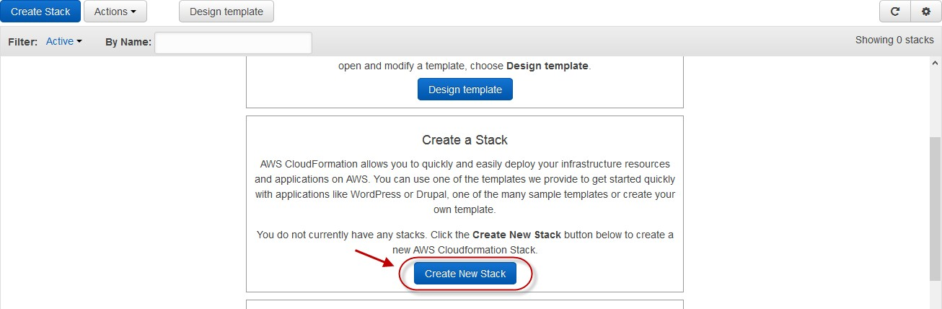
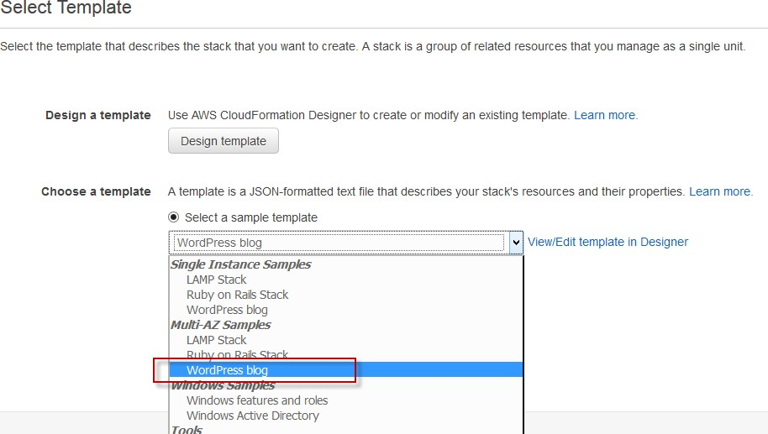
On the next page under Choose a template from the drop down list of select a sample template choose WordPress blog.
Then choose next to go to next page.

Slide 9
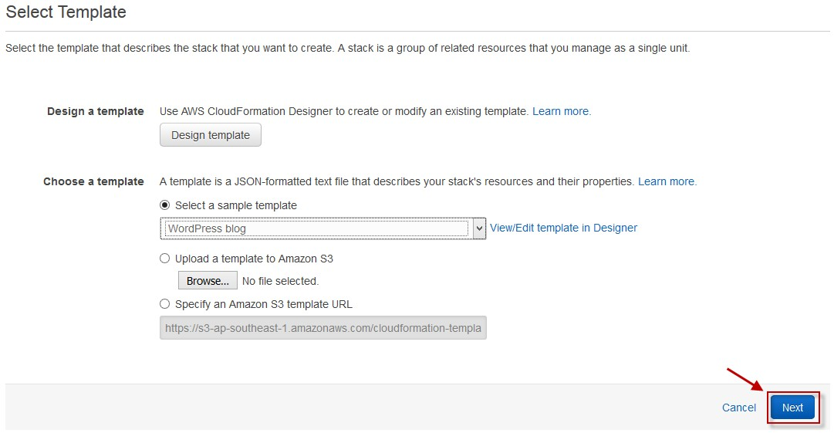
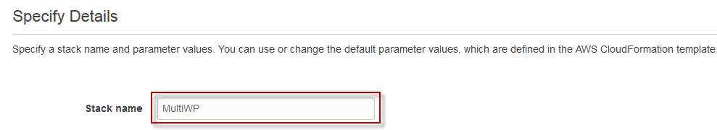
On Specify details, specify a stack name under stack name text field.
Then under Parameters section specify all required options then choose Next.

Slide 10
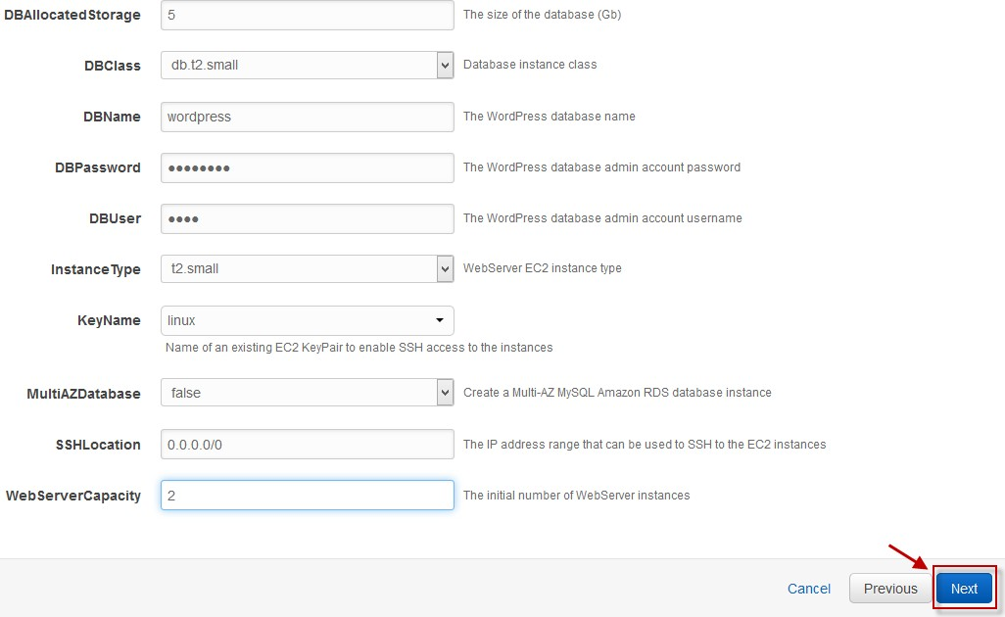
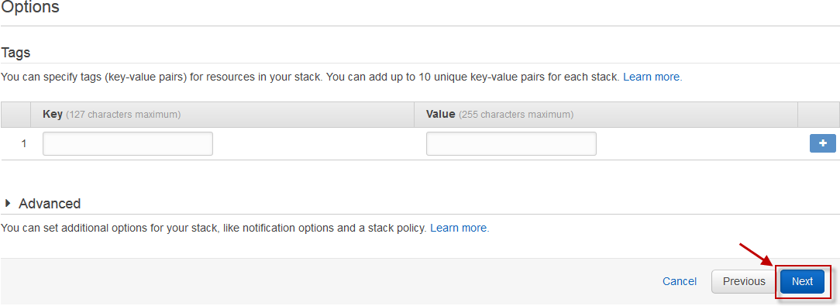
On the next page, specify Tags if you want, specify notifications which is under Advanced, then choose Next to continue.
Then click on Create below of the to create the Stack.

Slide 11
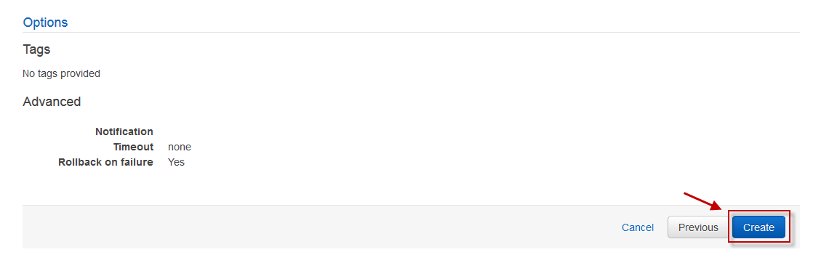
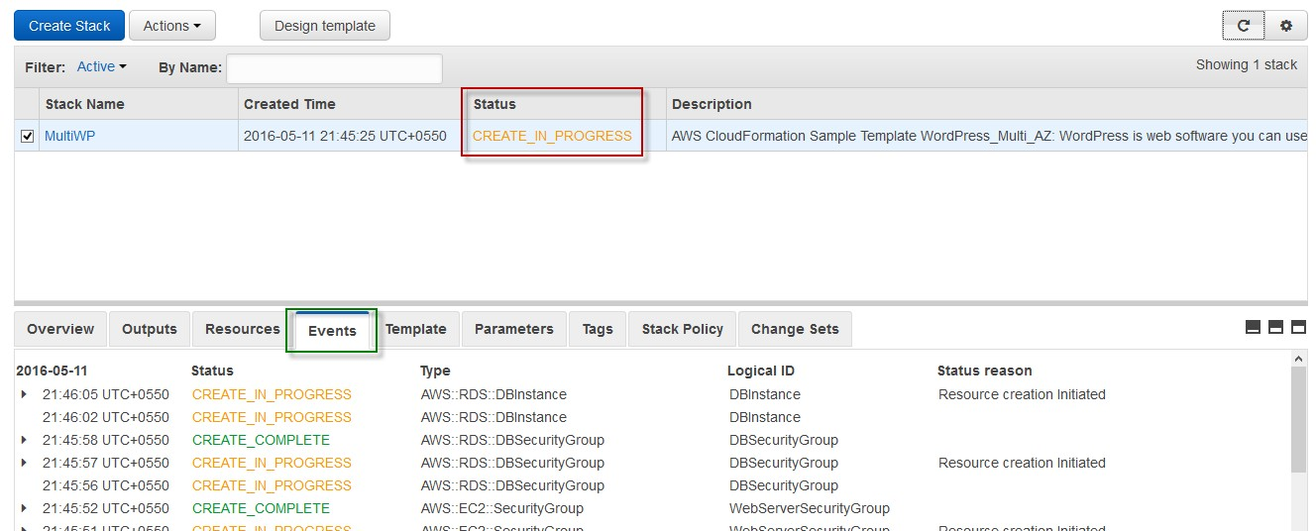
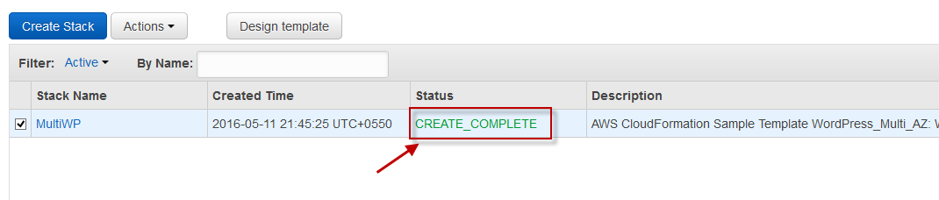
Then on the cloudformation page, you can see status of the stack as CREATE_IN_PROGRESS, you can also see the events under the Events tab.
Once created, stack status will change to CREATE_COMPLETE.

Slide 12
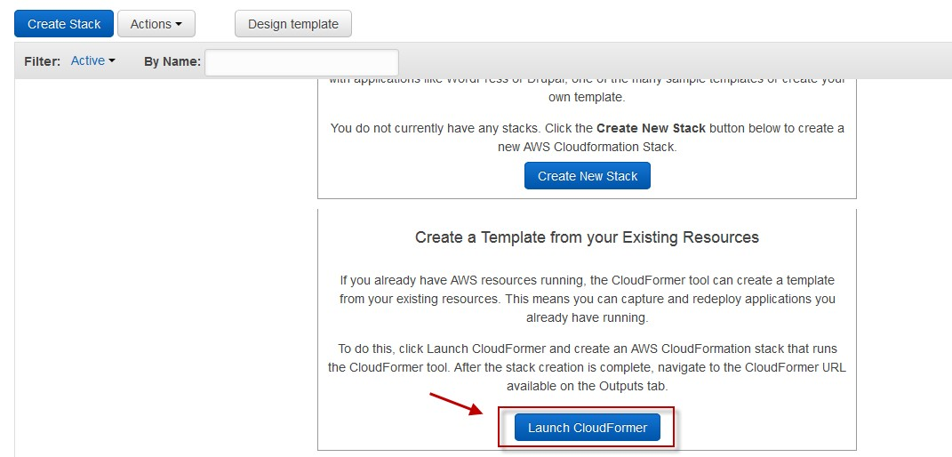
You can go and see the resources which were created by CloudFormation by going in to each services dashboard.
CREATE CLOUDFORMATON TEMPLATE FROM EXISTING ENVIRONMENT
Log in to AWS management console, then go to CloudFormation from the Console Home Page.
Then choose Launch CloudFormer.

Slide 13
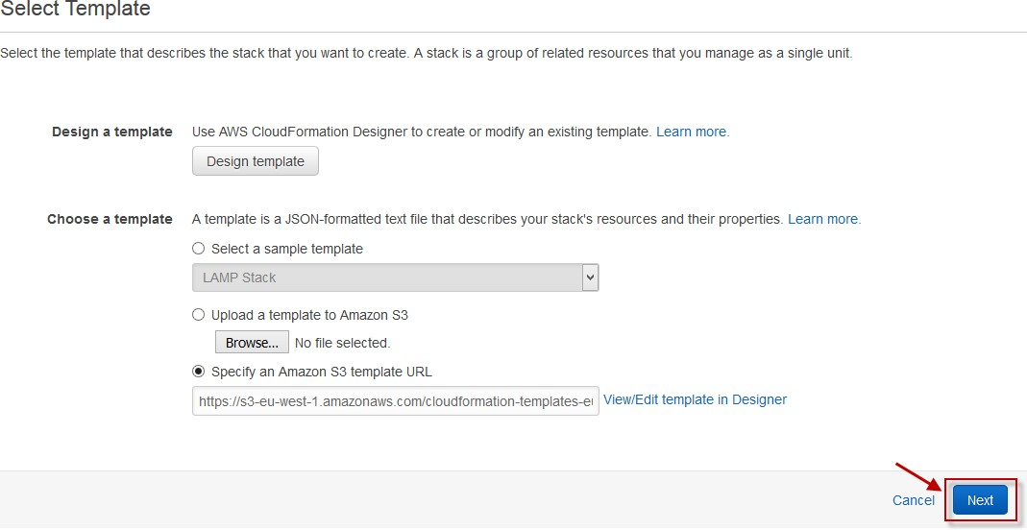
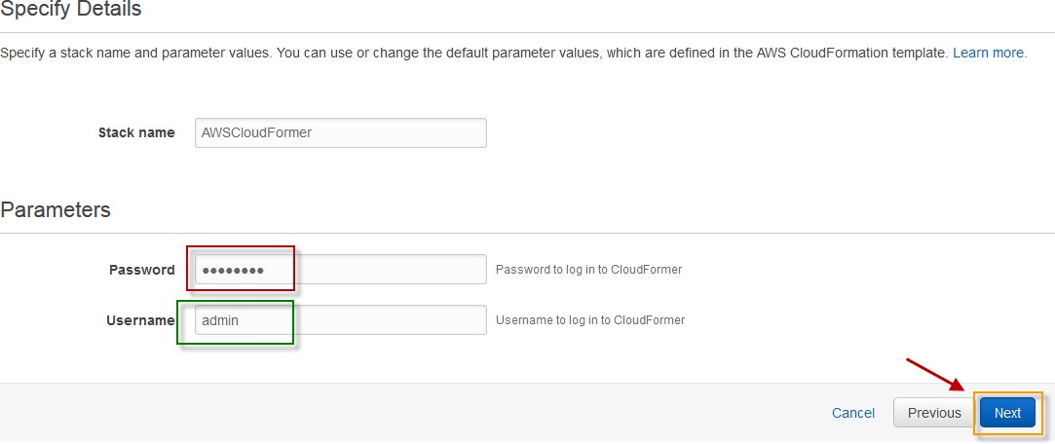
Then choose Next on Select Template page.
On Specify details page, specify username and password, then choose next to continue.
On the Options page, choose Next.

Slide 14
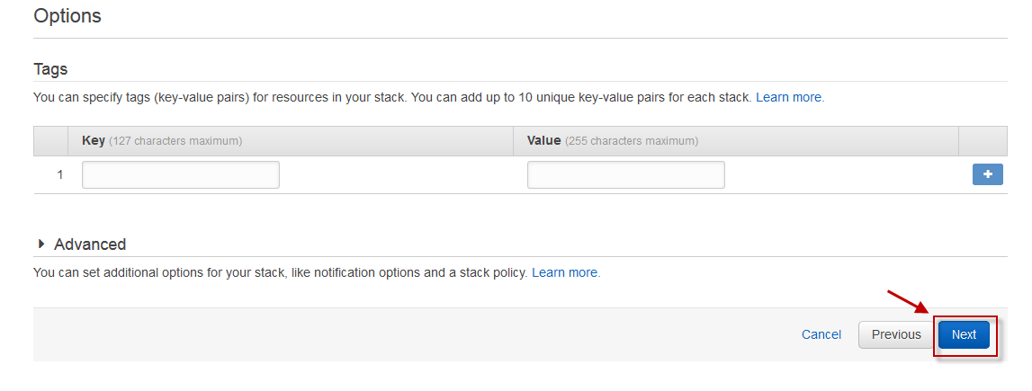
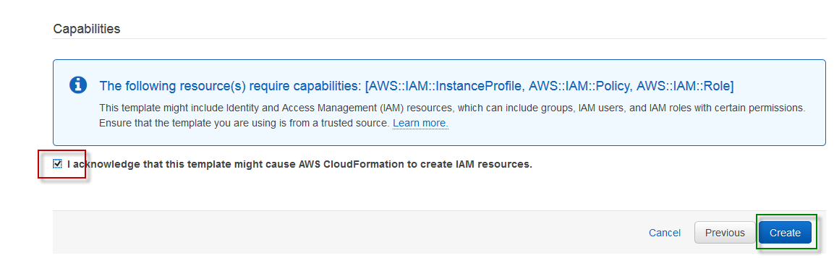
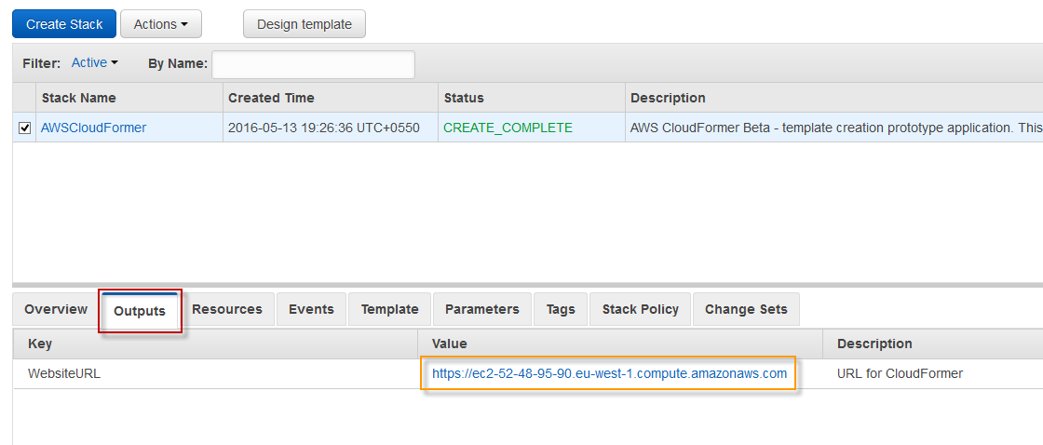
On the review page, go to below section of the page, check the acknowledgement box, then choose Create button.
Cloudformation will create a stack, once the stack creation has been completed. Go to Outputs section.
Copy the URL and open in your browser.

Slide 15
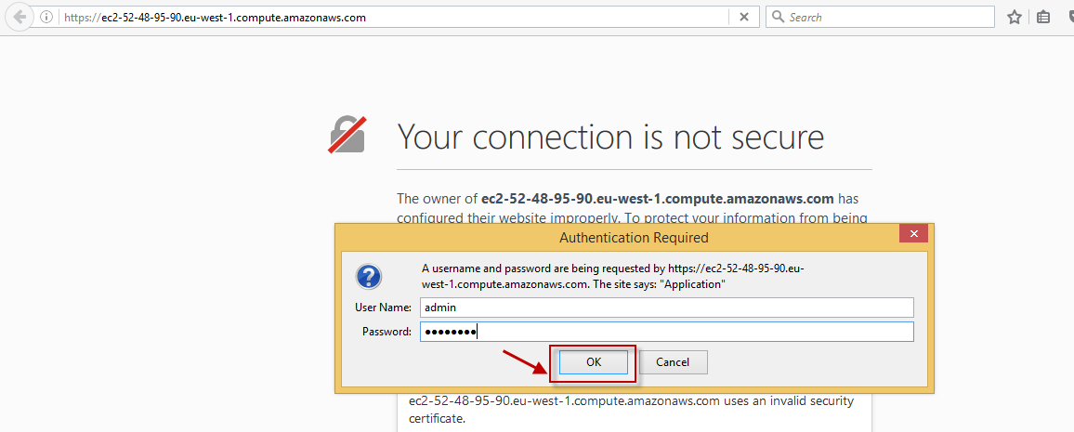
Once you have opened the URL, specify the username and password which you have specified while creating the stack, then click on Ok.
Once opened, choose your region where you have your resources from the Select the AWS region drop down list, then choose Create Template.

Slide 16
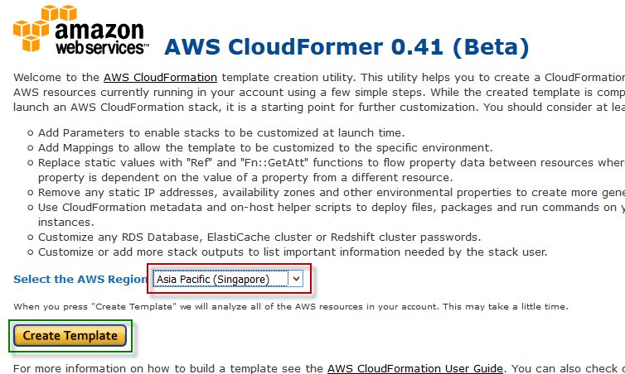

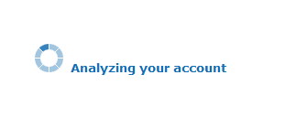
Wait for some time as it will analyse your account.
Then on the next page, add some Template description, select check box for all resources then choose continue tab above the page.

Slide 17
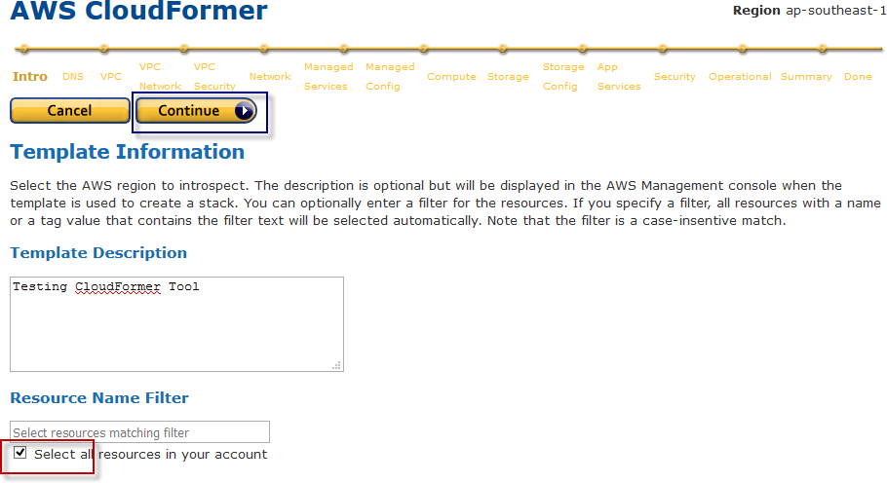
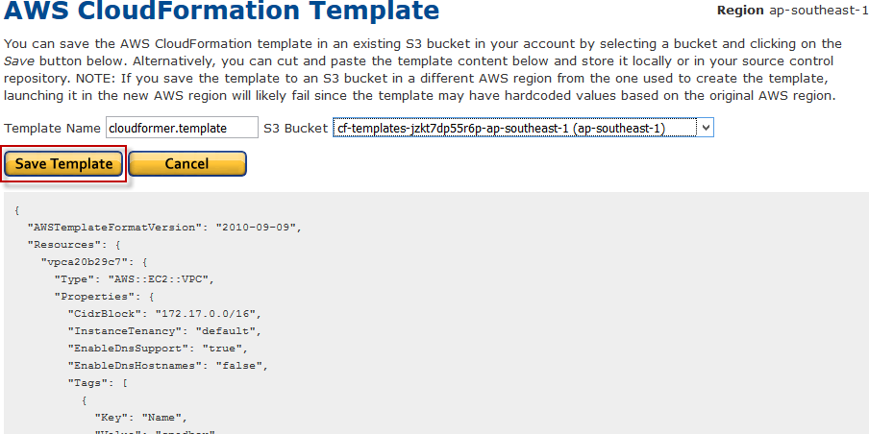
Choose resources by Service.
Once done you will have an option to save the template which is created by CloudFormer to S3 bucket or copy and save it in your desktop.

